Slide 1


IOT Project
Challenge '24

Slide 2
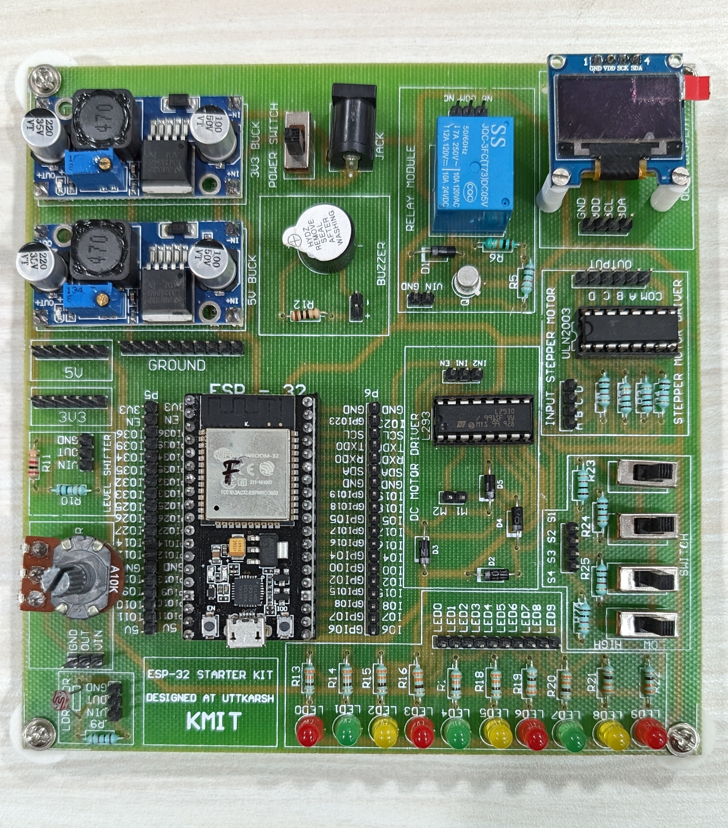
ESP32 STARTER KIT
ESP32 Microcontroller

Slide 3
ESP32 STARTER KIT
Components:
Level Shifter
Potentiometer
LDR Sensor

Slide 4
COMPONENTS OF ESP32 STARTER KIT​
OLED Display
Stepper Motor Driver
Switches
LEDs(red, green, yellow)

Slide 5
COMPONENTS OF ESP32 STARTER KIT​
5V &3.3V Buck converters
Relay
Buzzer
DC Motor Driver

Slide 6
Powering the ESP32 Kit

Slide 7
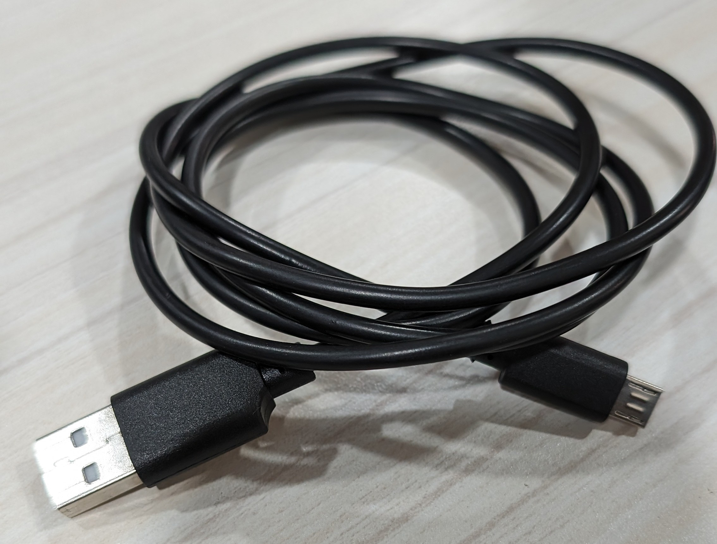
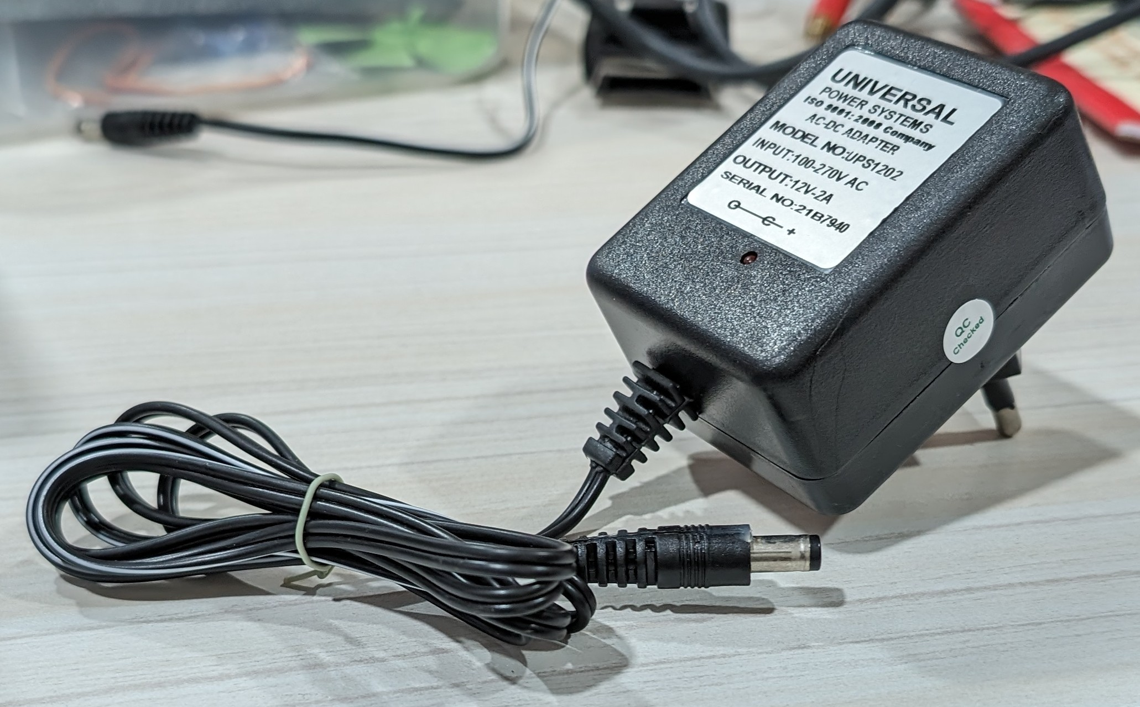
Power on/off Switch
Micro USB Cable
12 volts DC power Adapter
Note: Firmware has to be uploaded by connecting the USB cable to the Laptop.

Slide 8
Sensor Modules Included in the kit

Slide 10
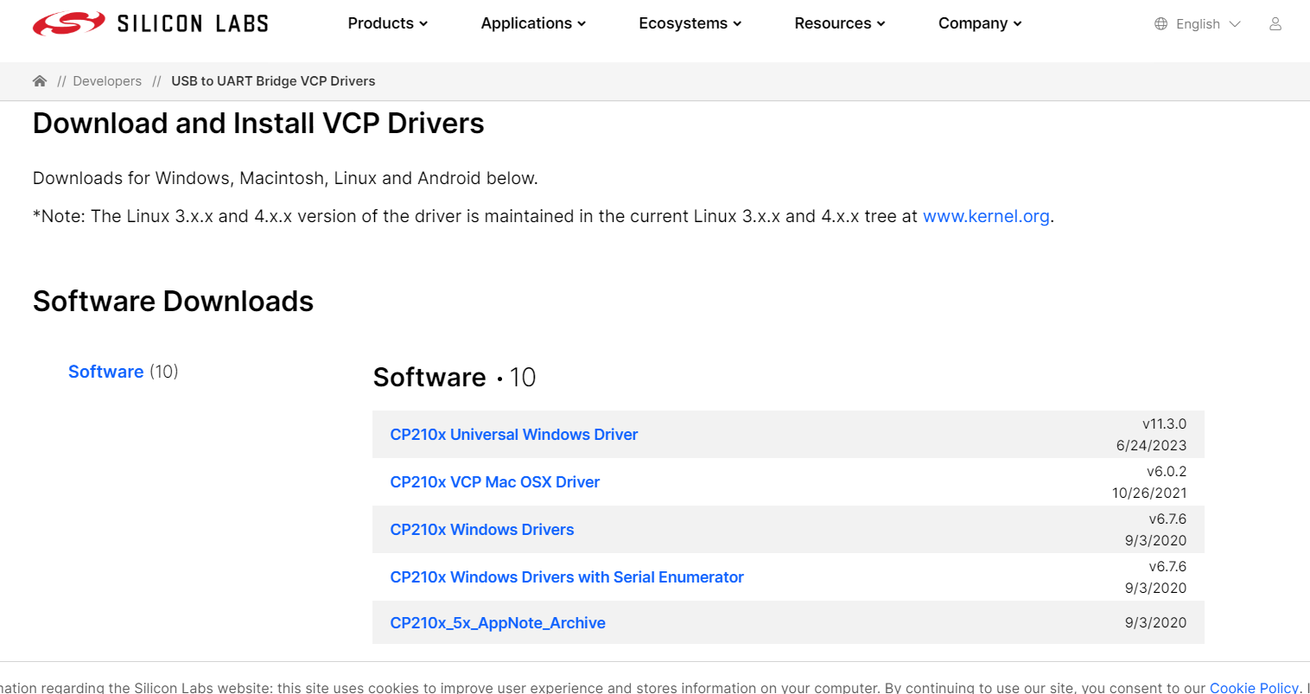
Silicon Labs CP210x USB to UART Bridge VCP Drivers
You need to install drivers for the USB-to-Serial chip on your ESP32 board. https://www.silabs.com/developers/usb-to-uart-bridge-vcp-drivers?tab=downloads

Slide 11
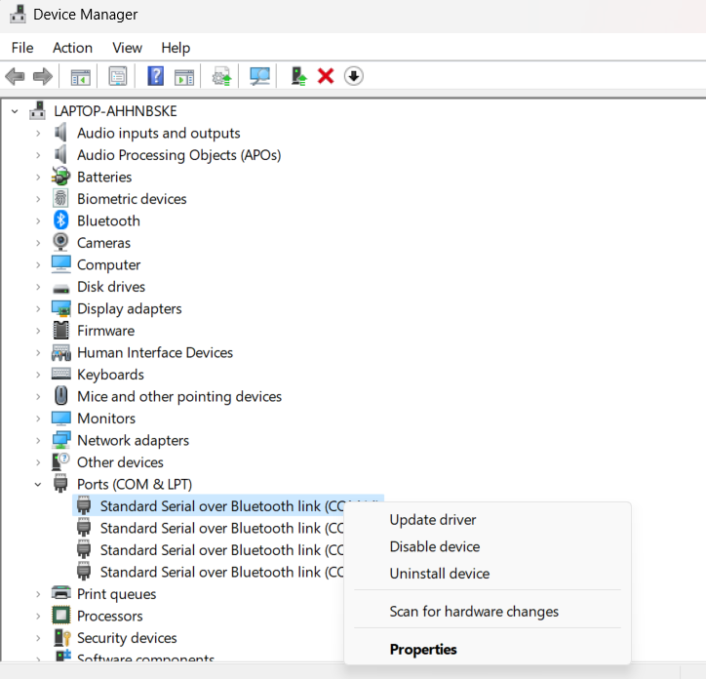
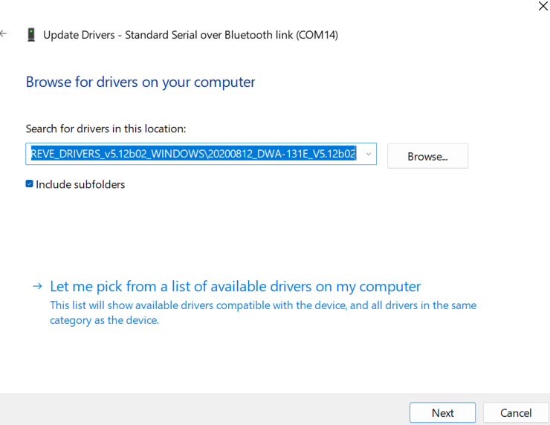
Extract the folder
Open Device Manager and Go to -> Ports
Connect your esp32 to laptop using micro-USB cable
It shows a new port, right click on it and select Update Driver
Browse the driver for extracted folder and click next
2​
1
3

Slide 12
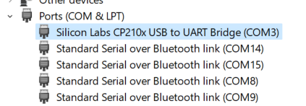
After uploading it shows

Slide 13

ARDUINO
Arduino is Open source based electronic programmable board (microcontroller)and software(IDE)
Accepts analog and digital signals as input and gives desired
output
No extra hardware required to load a program into the controller board

Slide 14
ARDUINO IDE
Arduino IDE is an open source software that is used to program the Arduino compatible controller board
Based on variations of the C and C++ Programming language
It can be downloaded from Arduino’s official website and
installed into PC
https://www.arduino.cc/en/software

Slide 15
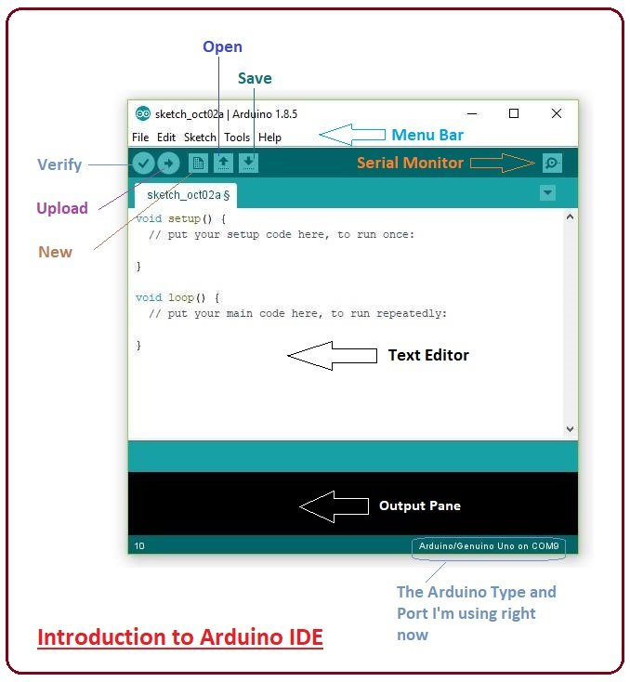
Arduino Sketch Structure
A sketch can be divided into two parts:
  Setup ()
  Loop()
The function setup() is the point where the code starts, just like the main() function in C and C++
I/O Variables, pin modes are initialized in the Setup() function
Loop() function, as the name suggests, iterates the specified task in the program

Slide 16
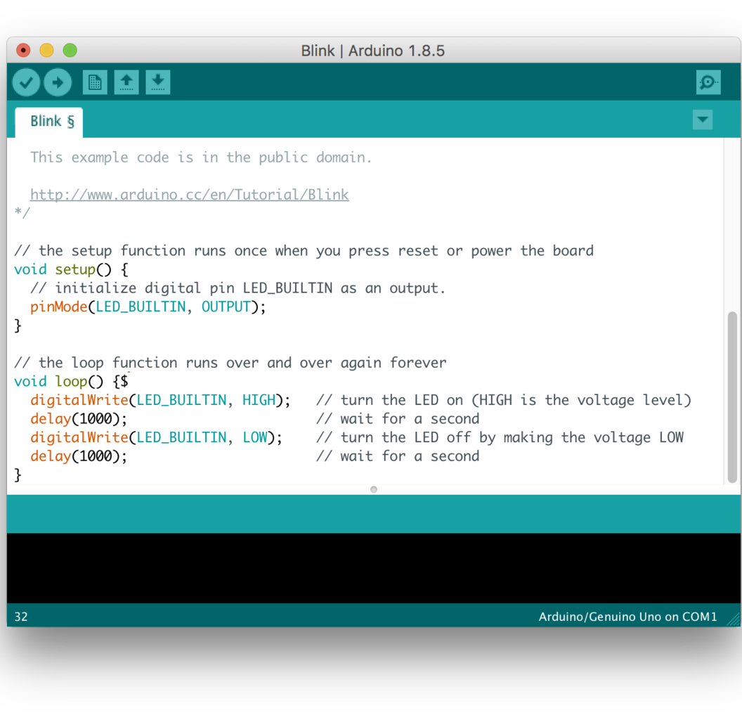
Arduino Function Libraries
Input/Output Functions:
  The arduino pins can be configured to act as input or output pins using the pinMode() function
Void setup ()
{
pinMode (pin , mode);
}
Pin- pin number on the Arduino board
Mode- INPUT/OUTPUT

Slide 17
Arduino Function Libraries (Contd..)
digitalWrite() : Writes a HIGH or LOW value to a digital pin
analogRead() : Reads from the analog input pin i.e., voltage applied across the pin
Character functions such as isdigit(), isalpha(), isalnum(), isxdigit(), islower(),
isupper(), isspace() return 1(true) or 0(false)
Delay() function is one of the most common time manipulation function used to provide a delay of specified time. It accepts integer value (time in miliseconds)

Slide 18
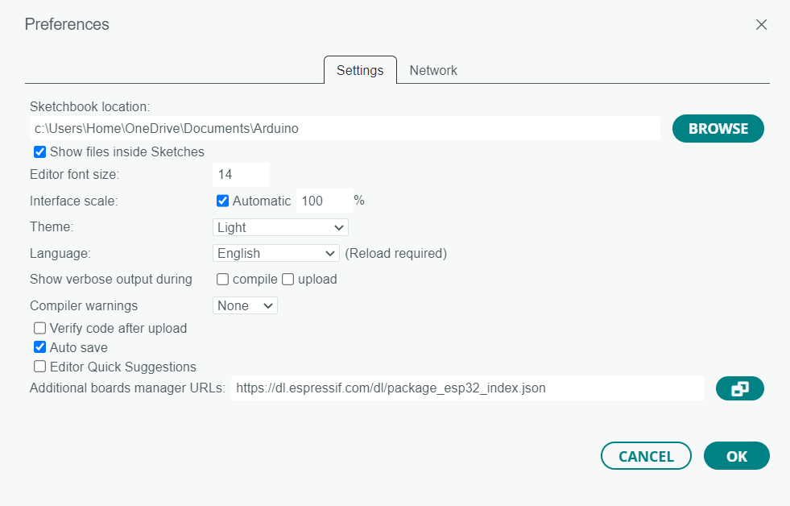
ESP32 BOARD SUPPORT TO ARDUINO IDE
Open Arduino IDE.
Go to File -> Preferences.
In the "Additional Boards Manager URLs" field, add this URL: https://dl.espressif.com/dl/package_esp32_index.json
Click OK to close the Preferences window.

Slide 19
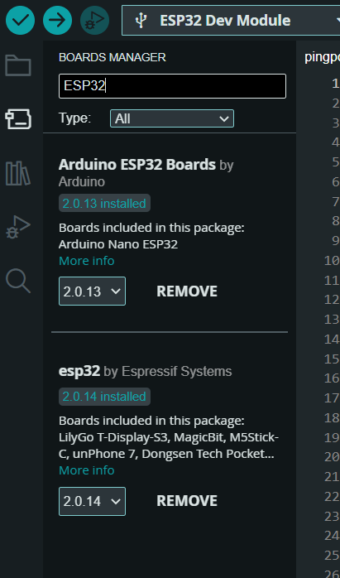
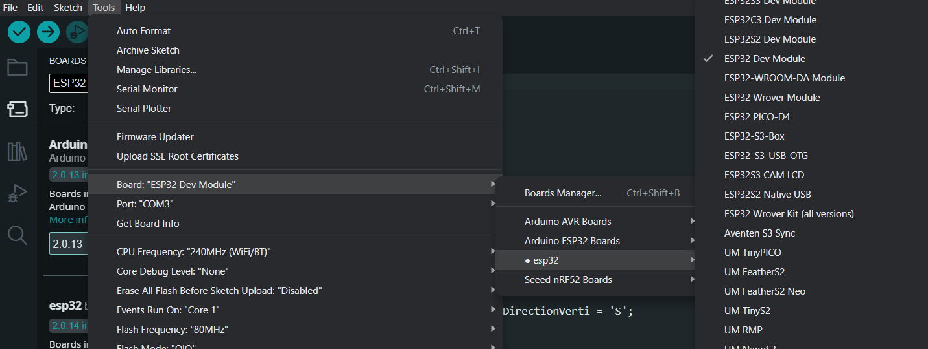
INSTALL ESP32 BOARD PACKAGE
Go to Tools -> Board -> Boards Manager.
Type "ESP32" in the search bar.
Install "esp32" by Espressif Systems.
Go to Tools -> Board.
Select your ESP32 board from the list. ("ESP32 Dev Module" for most generic ESP32 boards)

Slide 20
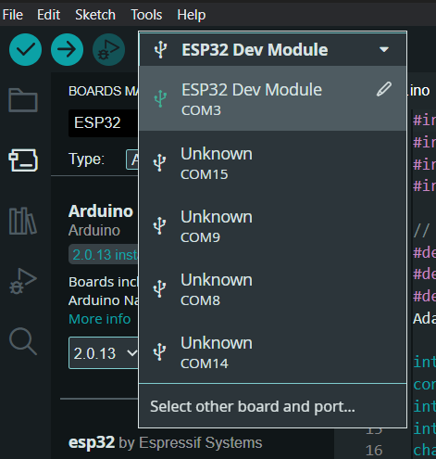
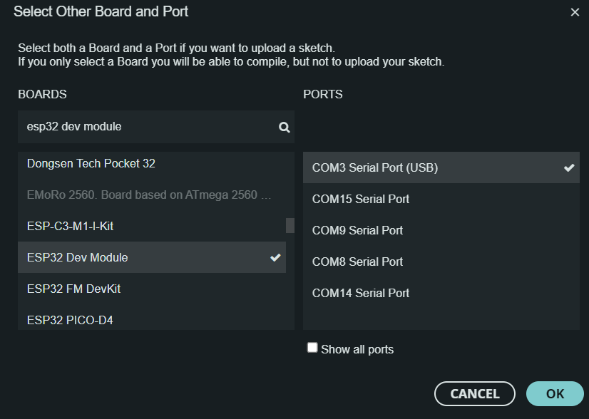
Open Arduino ide and select board and port
After selecting Board and Port you are good to upload your code.

Slide 21
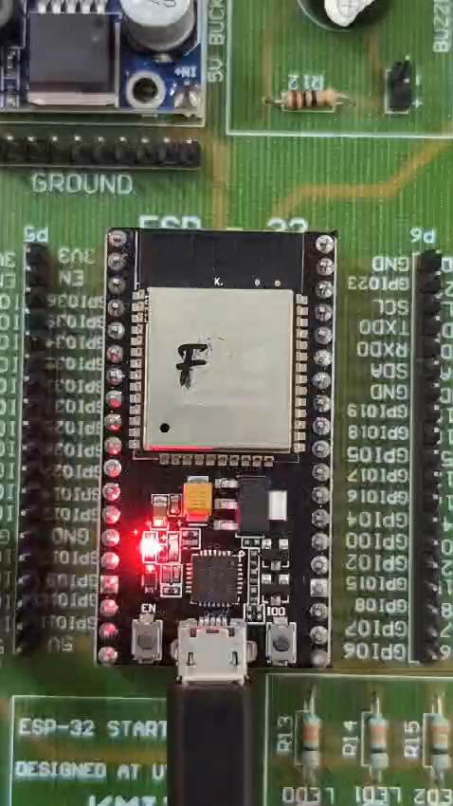
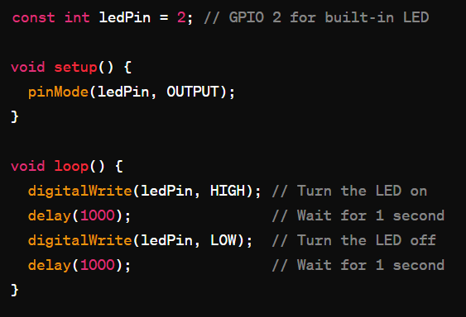
ESP32 Example code
Output:

Slide 22
Voice-controlled smart home with AI
Challenge #1

Slide 23
Problem Statement
Connect various devices to a microcontroller (lights, thermostat, etc.).
Implement a voice recognition system using a pre-trained AI model to control the devices.

Slide 24
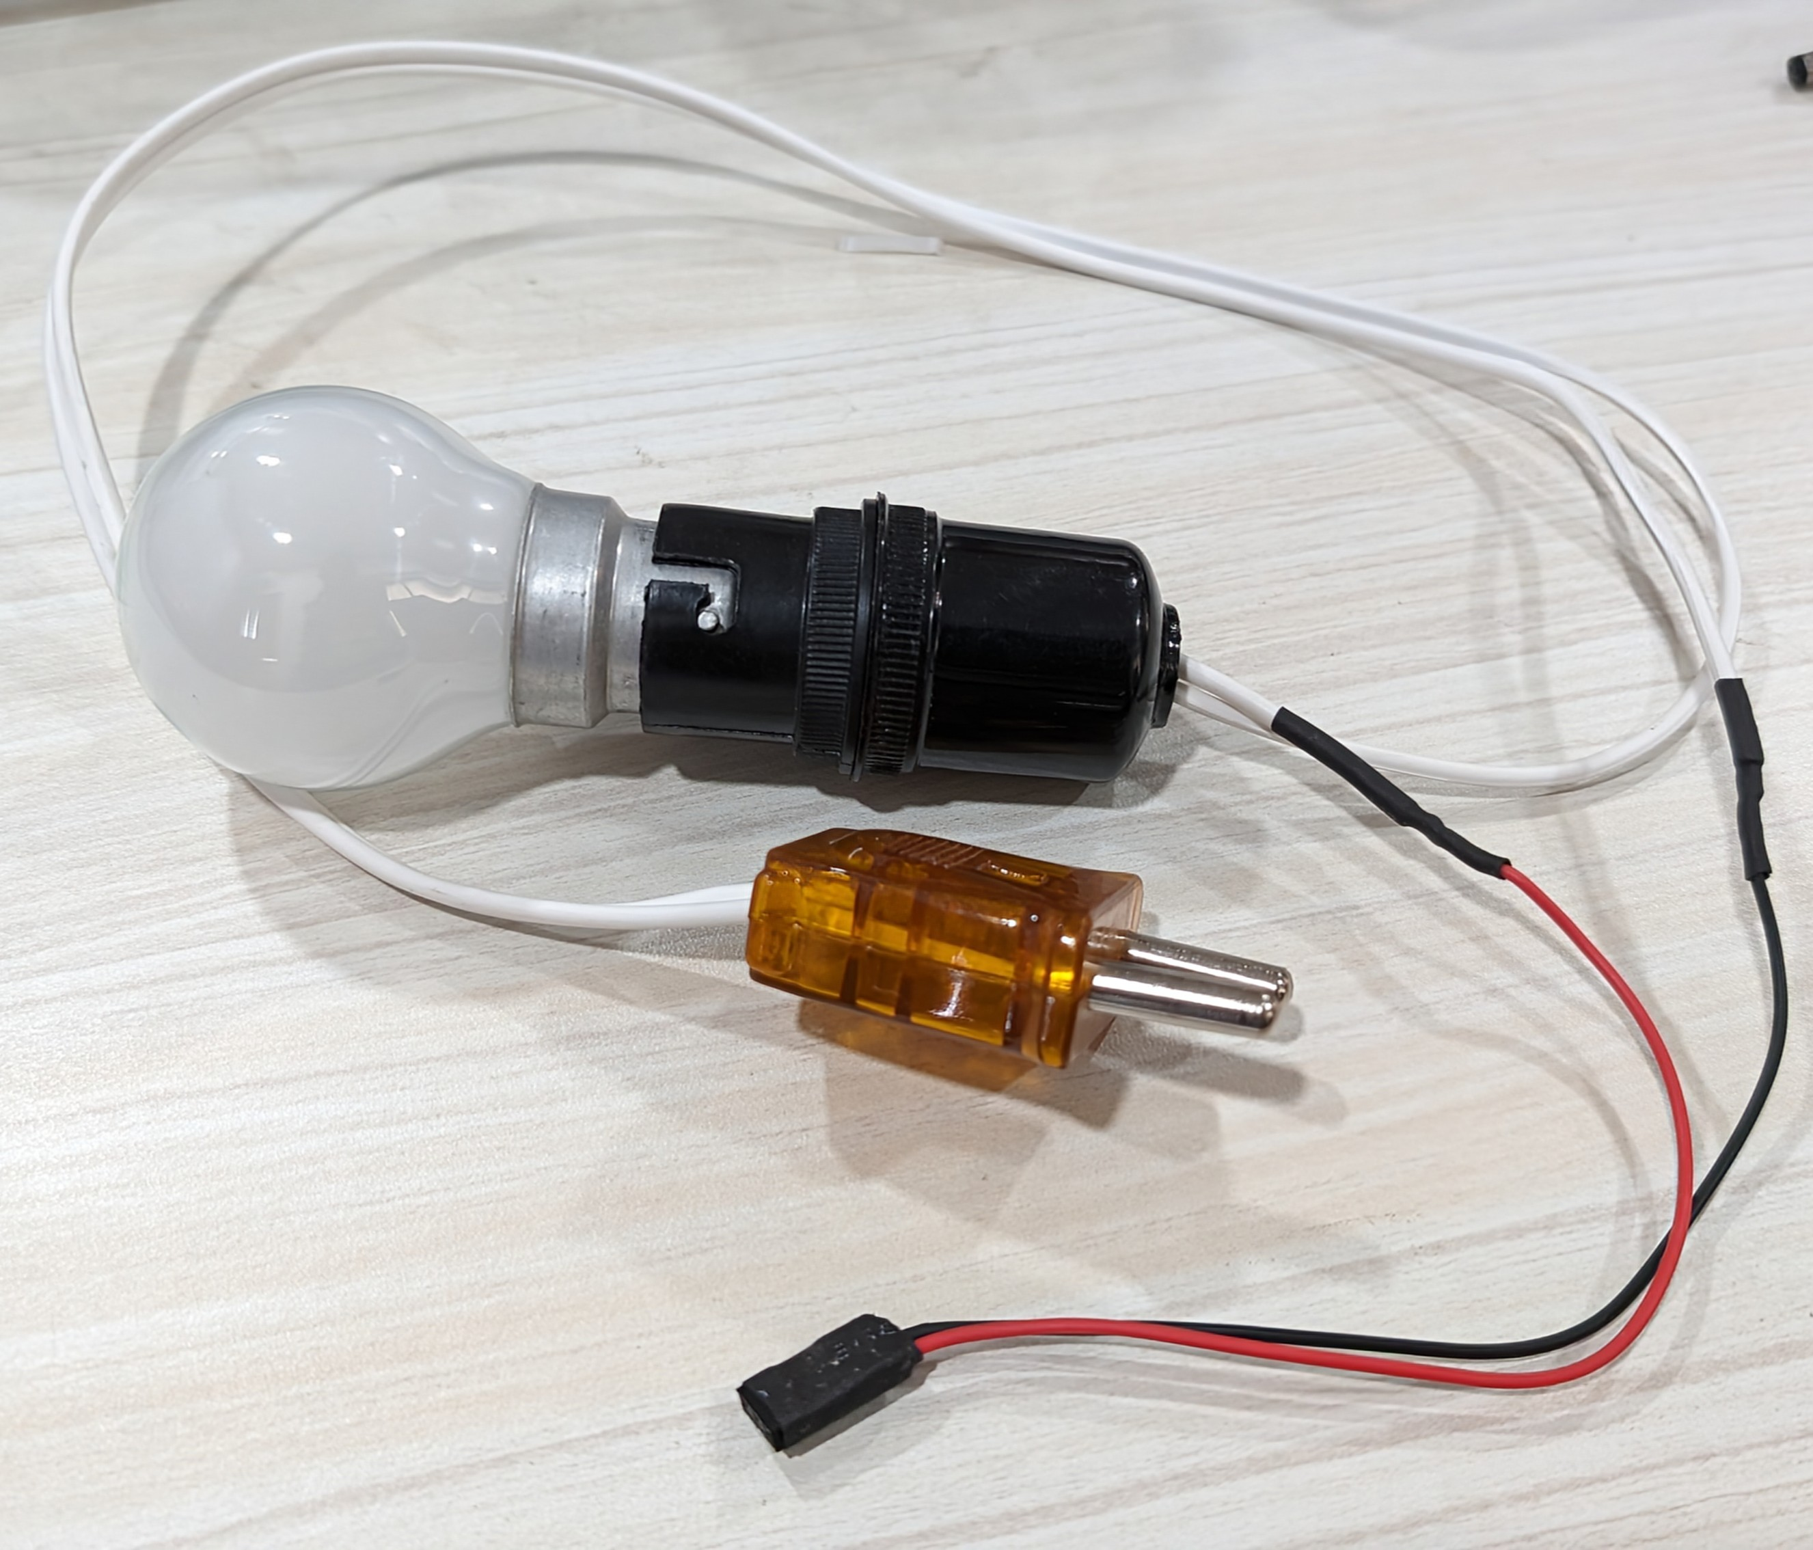
Components used:
Laptop with Microphone (Built-in or external)
Bulb module
KMIT ESP32 Development Kit

Slide 25
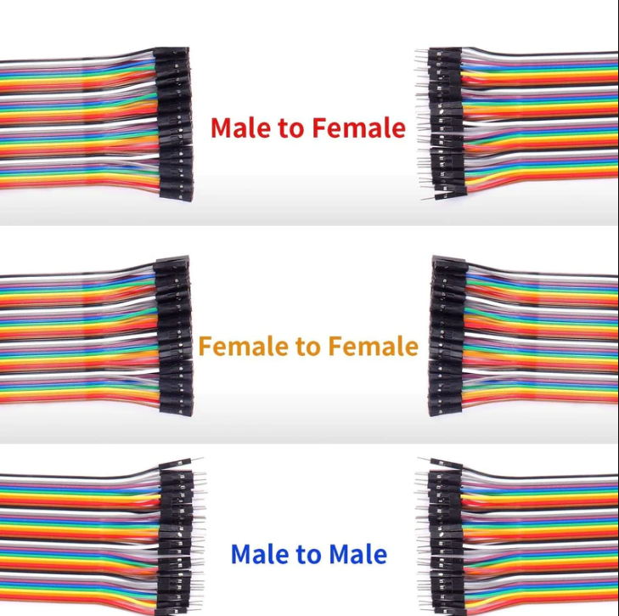
Jumper wires:
Jumper wires are simple electrical wires used to create connections between different points on a breadboard, electronic components, or between different components on a circuit board. They are a fundamental part of prototyping and building electronic circuits.
Types of Jumper Wires:
Male to Male (M-M):
  Both ends have male pins.
  Used to connect female headers, pins, or components with male headers.
Male to Female (M-F):
  One end has male pins, and the other has female sockets.
  Used to connect male headers to breadboards or female headers.
Female to Female (F-F):
  Both ends have female sockets.
  Used for connecting components with female headers or pins.

Slide 26
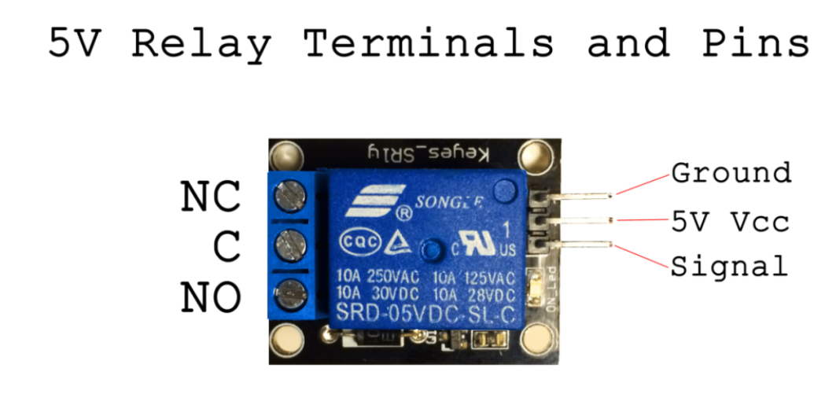
RELAY:
A relay is an electrically operated switch. It consists of a coil that, when energized, generates a magnetic field that causes a movable armature to move, either making or breaking an electrical connection. Relays are used in a variety of applications to control circuits electrically, which would otherwise require large and expensive switches.
Normally Open (NO): These contacts are open (not connected) when the relay is not energized. When the relay is energized, the contacts close (connect).
Normally Closed (NC): These contacts are closed (connected) when the relay is not energized. When the relay is energized, the contacts open (disconnect).
Common (COM): This is the common connection point for the NO and NC contacts.

Slide 27
Circuit Diagram:
Ground
Signal pin
COM
NO

Slide 28
Software Requirements:
Arduino IDE
Python (version 3.9 recommended)
Python libraries
  Speech recognition
  py audio

Slide 29
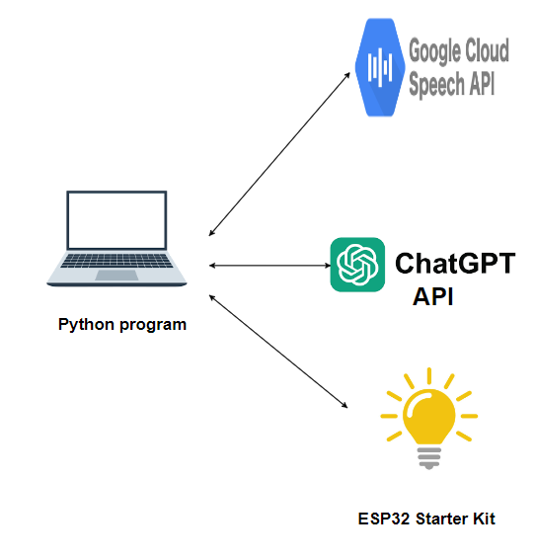
Architecture Diagram
Web API

Slide 30
LLM API URL:
http://dgx.kmitonline.in:4000/bulbapi

Slide 31
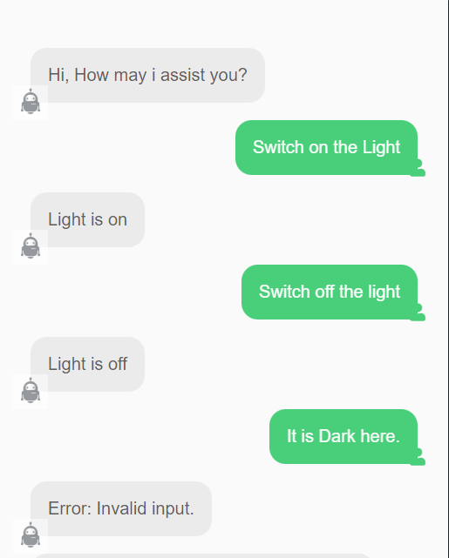
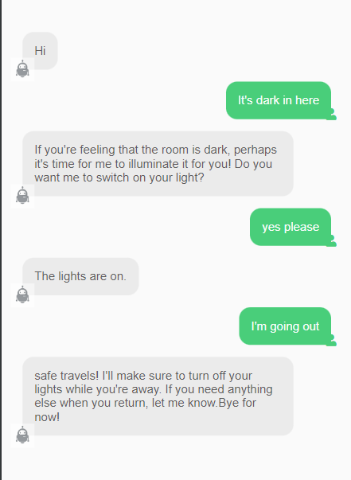
Basic smart Bulb
Advanced Smart Bulb

Slide 32
Sample Prompt

Slide 33
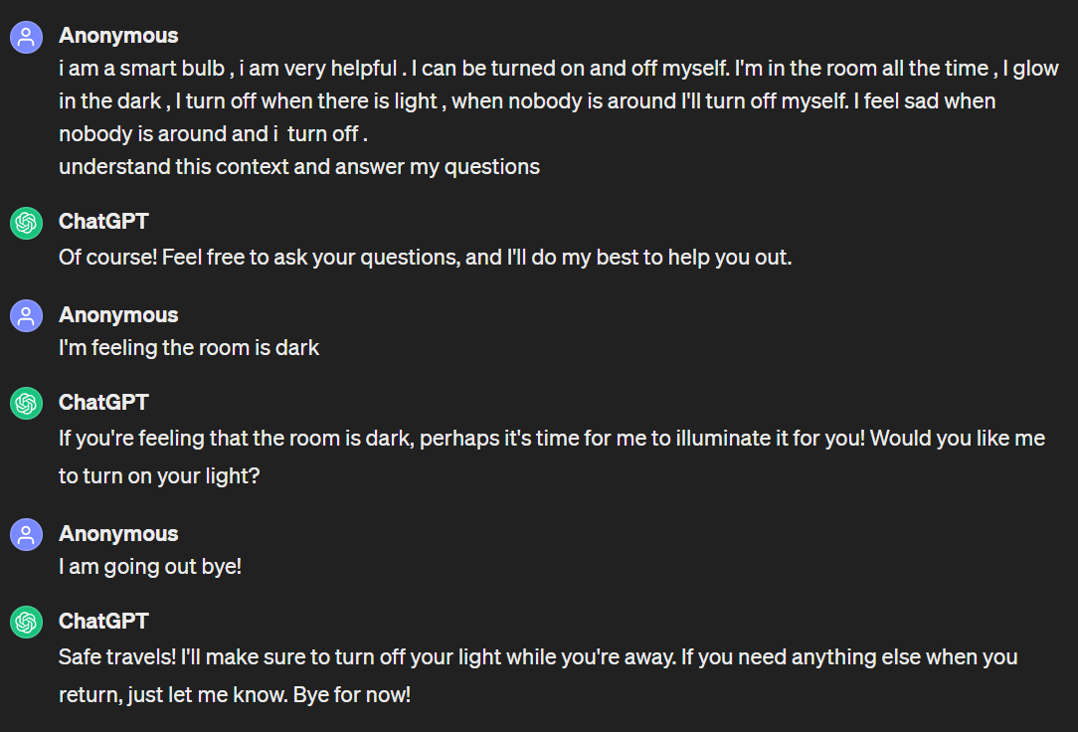

Slide 34
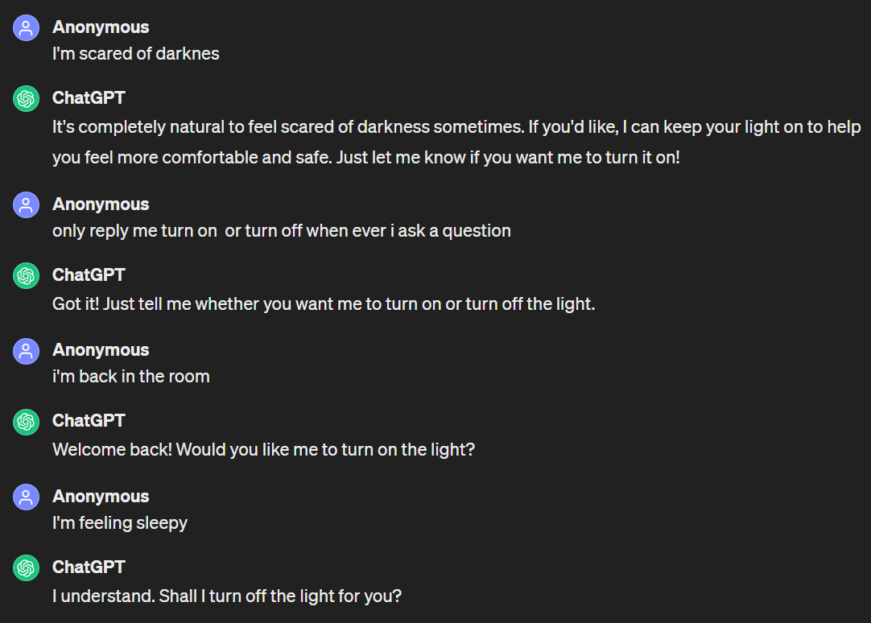

Slide 35
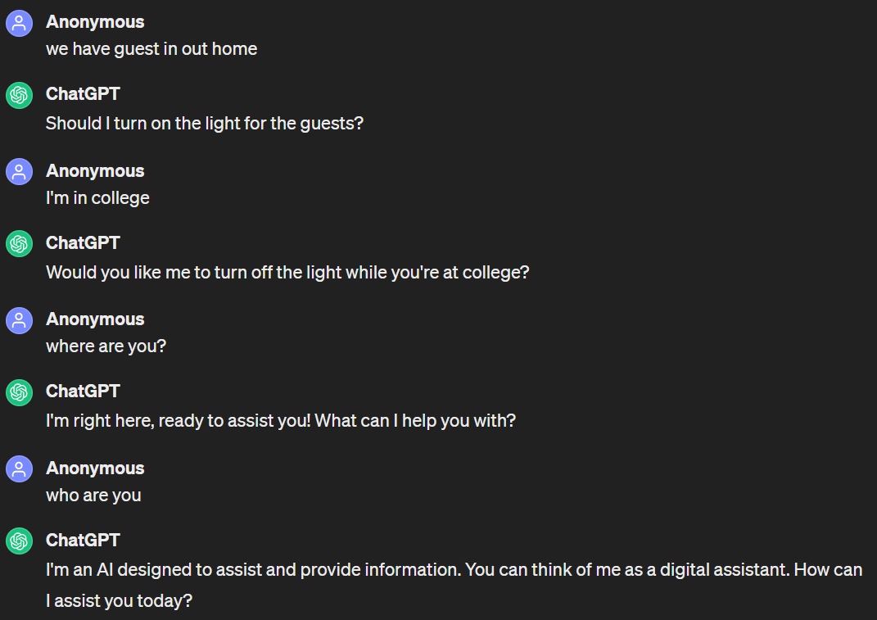

Slide 36
Intruder Alert System Using Facial Recognition
Challenge #2

Slide 37
Problem Statement
Develop an Intruder Alert System using Facial Recognition to enhance security. The system will train a model to recognize specific individuals through camera feeds. Upon detecting an unknown face, the system will activate an alarm to alert security personnel.

Slide 38
Components used:
Laptop with camera (Built-in or external)
KMIT ESP32 Development Kit
Buzzer

Slide 39
Circuit Diagram:
Signal pin
Ground

Slide 40
Software Requirements:
Arduino IDE
Python (version 3.7 recommended)
Python libraries
  opencv-python 4.9.0
  websocket-client 1.7.0
  imuitils 0.5.4
  Face-recognition 1.3.0

Slide 41
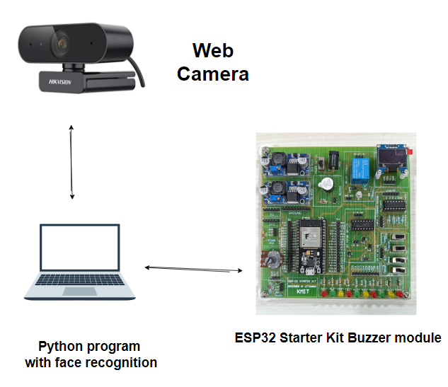
Architecture Diagram

